Slide 1
The Outsiders
Chapters 5-7 vocabulary

Slide 2
Groggy
Adjective
dazed, weak, or unsteady

Slide 3
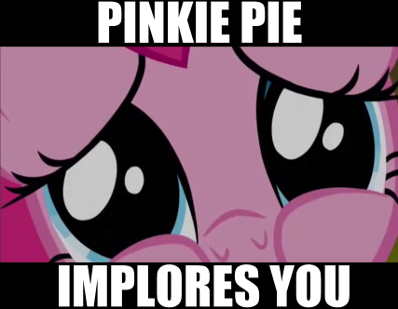
Implore
Verb
beg someone desperately
to do something.

Slide 4
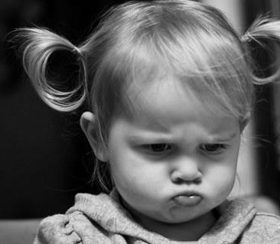
Sullen
Adjective
bad-tempered
and sulky; gloomy

Slide 5
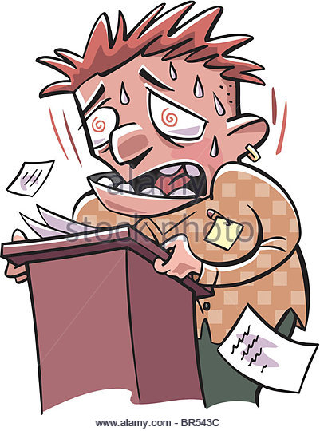
Quaver
Verb
shake or tremble of a person's voice when speaking, typically through nervousness or emotion

Slide 6
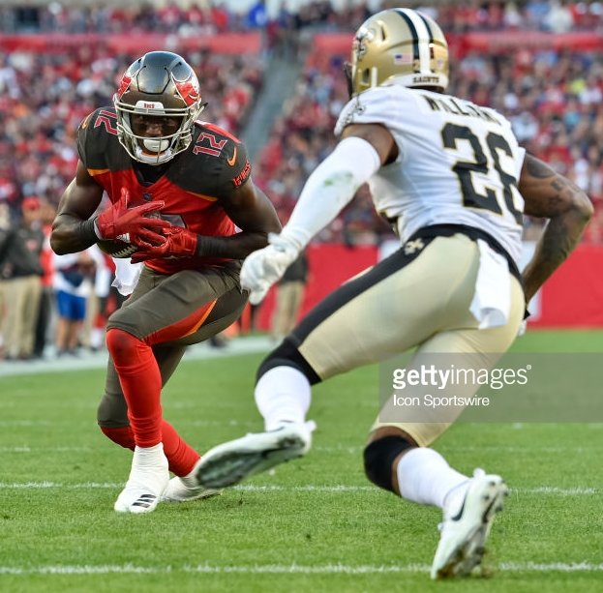
Elude
Verb
evade or escape from a danger, enemy, or pursuer, typically in a skillful or cunning way

Slide 7
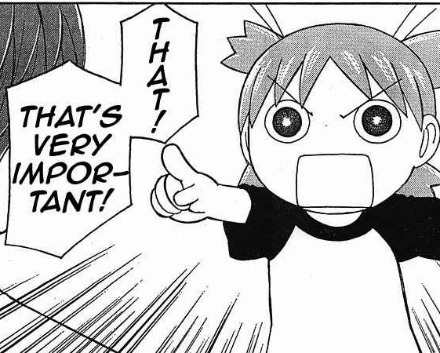
Vital
Adjective
absolutely necessary or important; essential.

Slide 8
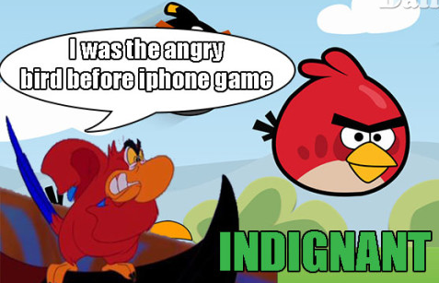
Indignant
Adjective
feeling or showing anger or annoyance at what is perceived as unfair treatment.

Slide 9
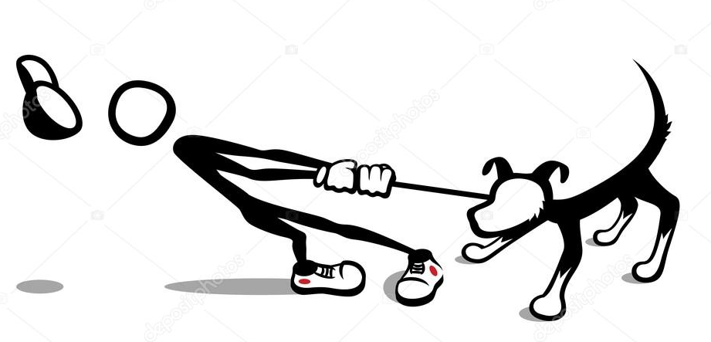
Reluctant
Adjective
unwilling and hesitant; disinclined.

Slide 10
Bewildered
Verb
Causes one to become perplexed and confused

Slide 11
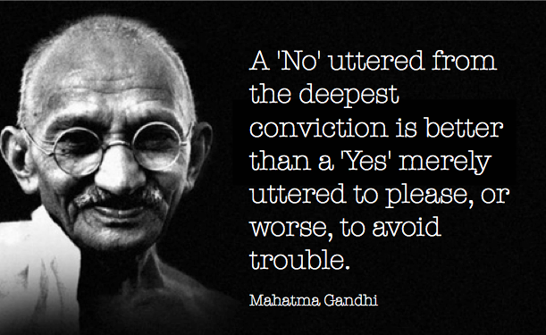
Conviction
Noun
a firmly held belief or opinion

Slide 12
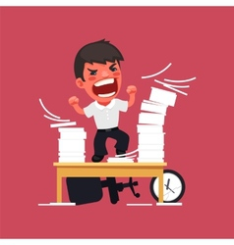
Hysterics
Noun
a wildly emotional and exaggerated reaction.

Slide 13
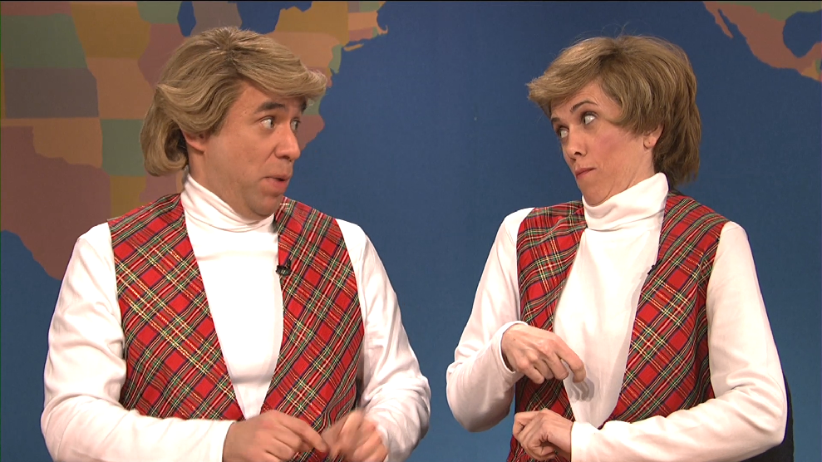
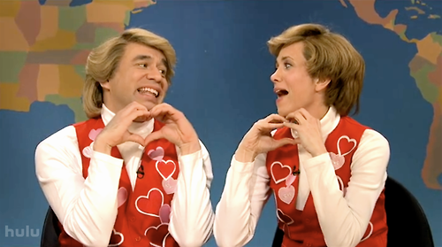
Mimic
Verb
To imitate someone or their actions or words, typically in order to entertain or ridicule.

Slide 14
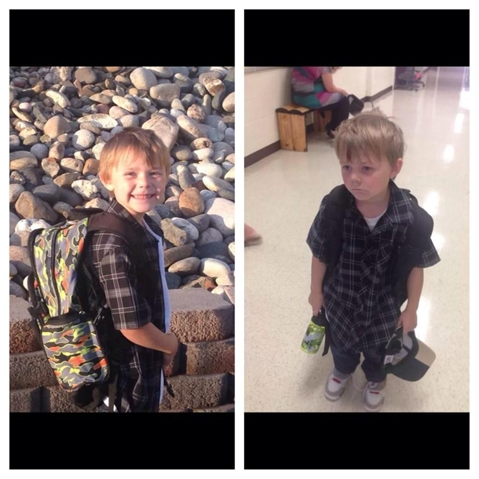
Bleak
Before
After
Adjective
not hopeful or encouraging; unlikely to have a favorable outcome of a situation or future prospect.
First Day of School

Slide 15
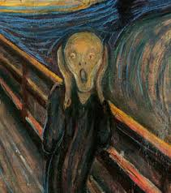
Aghast
Adjective
Filled with horror or shock

Slide 16
Contempt
Noun
the feeling that a person or a thing is beneath consideration, worthless, or deserving scorn.

